Slide 1
SQL Tool for PPT :
PPT Checker v.1
Anika Nower

Slide 2
Introduction
The “PPT Checker” can
  Generate configuration files (collection of shape’s property of a report) for PowerPoint reports
  Check formatting consistency between two reports

Slide 3
How to install and Pre-Requisites
Install the tool by running ‘setup.exe’ in a specific location of your PC.
Pre-Requisites (provided with the tool)
  .NET 4.0
  Windows Installer 3.1

Slide 4
HOW TO USE

Slide 5
Two Simple Steps…
Step 1: Generate Necessary Configuration files for reports
Step 2: Build the QC report
Assumptions:
When generating configuration of multiple reports, the reports should be in same folder location
New and Old reports should be in different folder location
Configuration files of new reports are placed in the new_config folder
Configuration files of old reports are placed in the old_config folder

Slide 6
Folder Structure
When the tool will be running for the first time, four different folders will be created in the application installation folder.
Suppose the tool is installed in “D:\PPT Checker” location. There will be four folders in that location.
  \New_Config: configuration files for new reports will be stored in this location
  \Old_Config: configuration files for new reports will be stored in this location
  \Log_files: error log files will be stored in this location
  \QC_Results: qc/comparison reports will be stored in this location

Slide 7
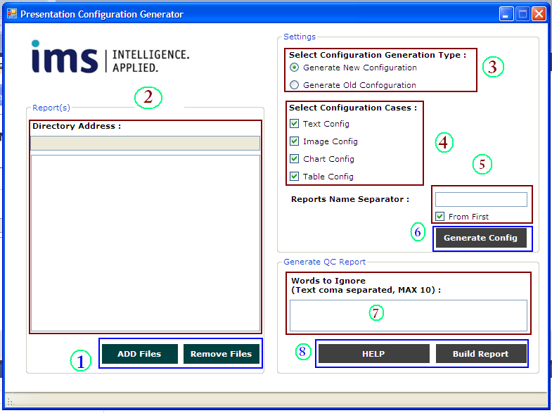
User Interface

Slide 8
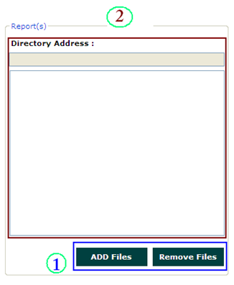
Generating Configuration: Step 1 & 2
Presentation reports can be added or removed by clicking the “Add files” and “Remove Files” button respectively.
  Please note that, loaded reports must be located in same folder
Files will be loaded in the ListBox and the directory address will be shown in the upper TextBox

Slide 9

Generating Configuration: Step 3
3. Please Select what type of configuration generation you want (by default new generation is selected)
  Generate Configuration file for new reports OR,
  Generate Configuration files for old reports

Slide 10
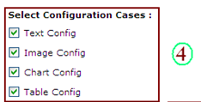
Generating Configuration: Step 4
4. Please select which type of shape property you want to generate (by default all shape property will be generated)

Slide 11
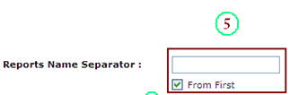
Generating Configuration: 5
5. Enter Separator character between current and previous reports file name in the TextBox.
*** If there is no difference in generated file names from previous and current production then leave the field empty.

Slide 12

Generating Configuration: Step 6
6. Click the button to generate the Configuration of reports.
*** Necessary Report files should be Loaded and selected in the ListBox
*** Step 1 to 5 should be configured
***generated configuration file will be found in “New_config” folder if ‘new generation’ option selected, otherwise configuration files will be found in “Old_config” folder

Slide 13
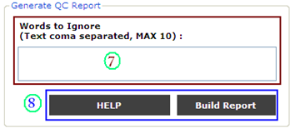
Generation of QC report: Steps
7. Enter necessary words to ignore in the TextBox while comparing two reports (comma separated and MAX 10)
*** If there is no words to ignore, then left the textBox empty
8. By clicking “Build Report” button will generate the QC report and the report will be found in the “QC_Results” folder
*** “Help” button will open this “User manual” presentation file.

Slide 14
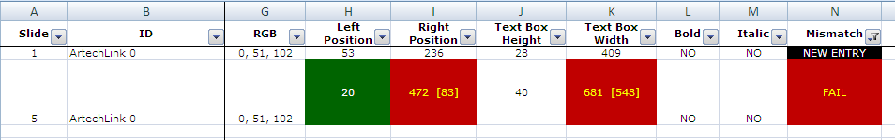
Understanding the QC report
Column is filtered according
To the “FAIL” and “New Entry”
Criteria
Mismatch in value
Mismatch
But
Text Ignored
Newly added
element/property
Different TAB color to understand
Which sheet is ok and which is not!

Slide 15
Thank You!

